Slide 1
Chapter 2: Getting to know data in Python

Slide 2
Python Data Types

Slide 3
Data types
None
Number (integer, float, complex)
Boolean
Sequences (mutable, immutable)
Set
Dictionary

Slide 4
None
It signifies the absence of value
>>> None
Example: checking something is absent or not
>>> incentive = 100
>>> if incentive is None:
print(‘No incentive’)
else:
print(‘Received incentive’)

Slide 5
Number: Integer
It is a mathematical integer that has an unlimited range between negative number to positive number
>>> a = 1
>>> b = -100
>>> c = 10_000_000
Invalid integer
>>> x = 01
Not integer
>>> y = ‘1’

Slide 6
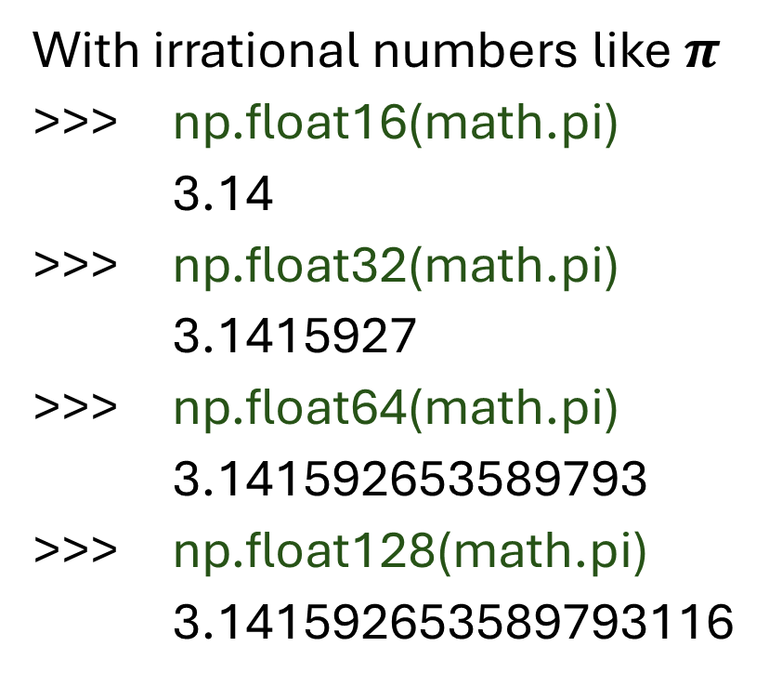
Number: float
An approximation of a real number given a degree of precision
>>> a = 3.
>>> b = 3.0
>>> c = 3e0
>>> d = 1_000.125
With irrational numbers like $π$
>>> np.float16(math.pi)
3.14
>>> np.float32(math.pi)
3.1415927
>>> np.float64(math.pi)
3.141592653589793
>>> np.float128(math.pi)
3.141592653589793116

Slide 7

Number: Complex number
In math, $\sqrt{−1}=1i$, and this is a type of complex number
In Python, this can be implemented too
>>> import cmath
>>> cmath.sqrt(-1)
1j

Slide 8
Boolean
It has only 2 values:
>>> True
>>> False
OR
>>> bool(1)
True
>>> bool(0)
False
>>> int(True)
1
>>> int(False)
0
Example of use case:
>>> 3 > 2
True
>>> 3 < 2
False
>>> heights = [1.54, 1.75, 1.80, 1.64]
>>> [height for height in heights if height >= 1.6]
[1.75, 1.8, 1.64]

Slide 9
Sequences (mutable, immutable)
These represent finite ordered sets indexed by non-negative numbers
When the length of a sequence is n, the index set contains the numbers 0, 1, …, n-1
An object of an immutable sequence type cannot change once it is created
Mutable sequences can be changed after they are created.

Slide 10
Immutable Sequence: String
A string can be created by using wrap-around quotation marks:
'snack’
"snack“
'''snack'‘’
"""snack""“
>>> a = 'iLikeIt’
>>> a[0]
‘i’
>>> a[3]
‘k’
>>> a[2] = 'b’
TypeError: 'str' object does not support item assignment

Slide 11
Immutable Sequence: Bytes
8-bit bytes represented by integers in the range 0 <= x < 256.
>>> a = b‘I like Python’
b‘I like Python’
>>> a[0]
105
>>> a[0] = 117
TypeError: 'bytes' object does not support item assignment

Slide 12
Immutable Sequence: Tuple
>>> a = 1, 2, 3
(1, 2, 3)
>>> b = (1, 2, 3)
(1, 2, 3)
>>> c = tuple([1, 2, 3])
(1, 2, 3)
>>> c[2]
3
>>> c[2] = 4
TypeError: 'tuple' object does not support item assignment

Slide 13
Mutable sequence: List
>>> a = [‘hello’, ‘world’, ‘something’]
>>> b = list([‘hello’, ‘world’, ‘something’])
>>> b[2]
‘something’
>>> b[2] = ‘new thing’
>>> print(b)
[‘hello’, ‘world’, ‘new thing’]

Slide 14
Mutable sequence: byte array
8-bit bytes represented by integers in the range 0 <= x < 256.
>>> a = bytearray(‘I like Python’, ‘utf-8’)
bytearray(b‘I like Python’)
>>> a[0]
105
>>> a[0] = 117
>>> print(a)
bytearray(b'u like Python')

Slide 15
Set
Unordered, finite sets of unique, immutable objects
>>> set([3, 5, 2, 1])
{1, 2, 3, 5}
>>> set([1, 1, 1, 2, 2, 2, 3])
{1, 2, 3}

Slide 16
Dictionary
A key-value pair like json
>>> a = {
‘name’: ‘Brown’,
‘age’: 25
}
>>> a = dict(name = ‘Brown’, age = 25)

Slide 17
Data in Pandas
A fast, powerful, flexible and easy to use open source data analysis and manipulation tool.

Slide 18
Pandas Series
It is a one-dimensional array, a basic building block in Pandas
>>> import pandas as pd
>>> pd.Series([1, 2, 3])
>>> pd.Series((1, 2, 3))

Slide 19
Pandas DataFrame
2 Dimensional arrays with columns and rows
>>> d = {'col1': [1, 2], 'col2': [3, 4]}
>>> df = pd.DataFrame(data=d)

Slide 20
Pandas/Numpy array vs Python sequence
Let’s do a performance comparison over a series of numbers between 0 to 1_000_000 multiplied by 2. Data processing with Numpy array is 33 times faster than Python List.
ls = [i for i in range(0, 1_000_001)]
%%timeit
for i in ls:
i * 2
Result: 165 ms ± 48.7 ms per loop (mean ± std. dev. of 7 runs, 1 loop each)
arr = np.arange(0, 100_000_001, 1)
%%timeit
arr * 2
Result: 5.06 ms ± 125 μs per loop (mean ± std. dev. of 7 runs, 100 loops each)

